Slide 1
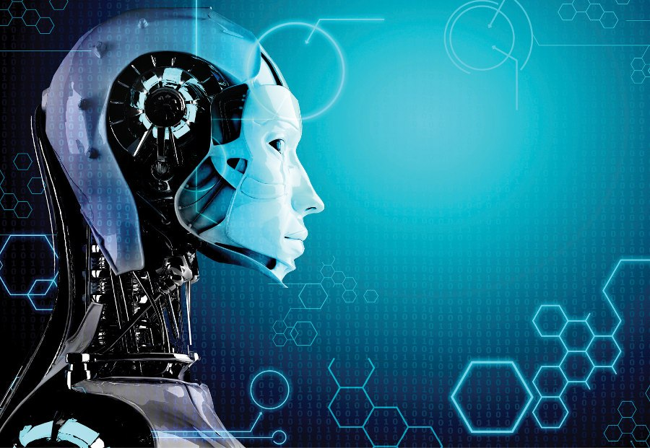
ROBOTICS

Slide 2

contents
Introduction
What is Robotics?
History of Robotics
The first Robot
The robotics technology?
The future of Robotics

Slide 3
Introduction to robotics
Robots have become a subject of great interest nowadays.
In our imagination robots is a machine that looks and acts like human beings.
Robots are in fact, defined as man made mechanical devices that can move by themselves, whose motion must be modeled, planned, sensed, actuated and controlled and whose motion and behavior can be influenced by “programming”

Slide 4
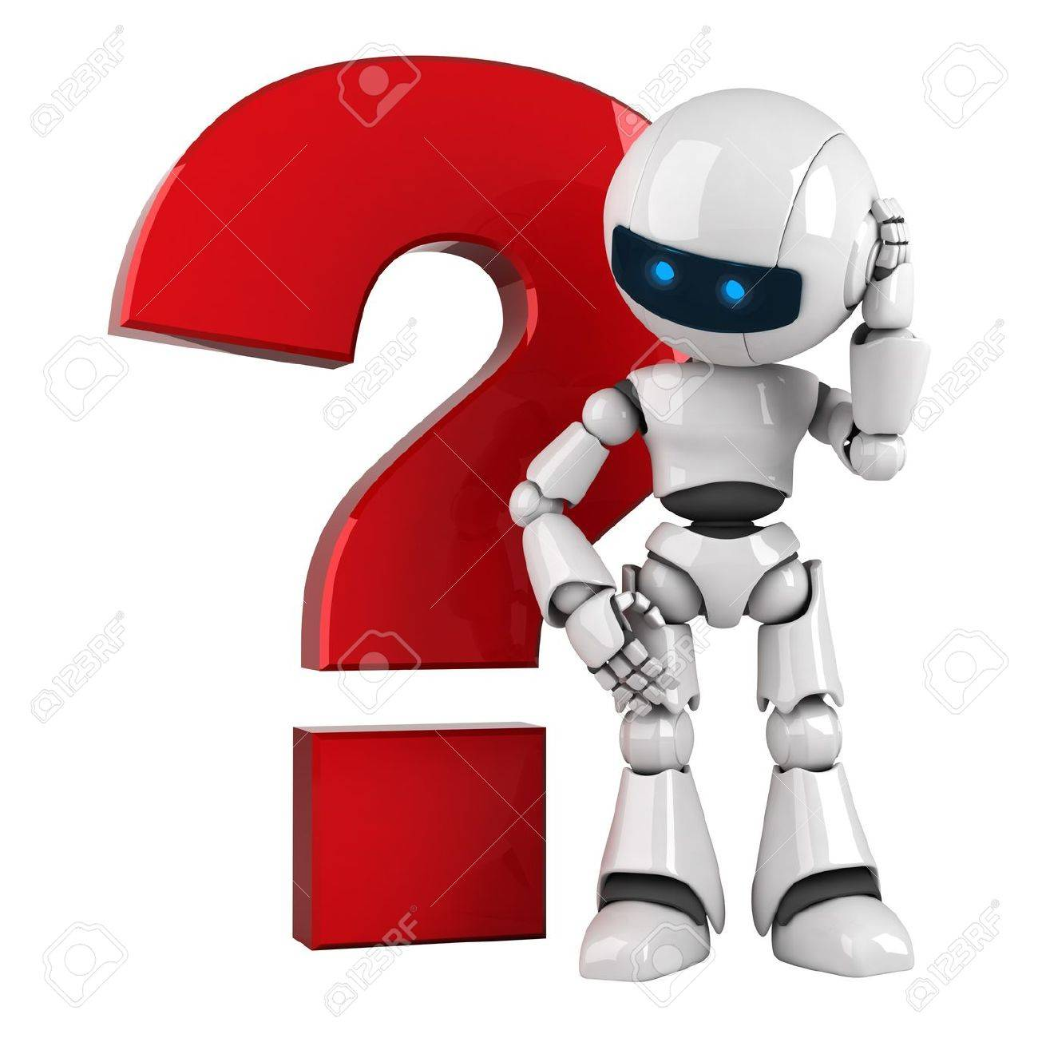
What is Robotics?
The field of computer science and engineering concerned with creating Robots. It involves the designs, operation and structure of Robots. A robot is a man made computerized machine which performs task on human commands or by themselves and seek to make work easier for human beings.
A Robot is an integrated system made up of sensors, control systems and a software which work co-dependently in order to perform a task.

Slide 5
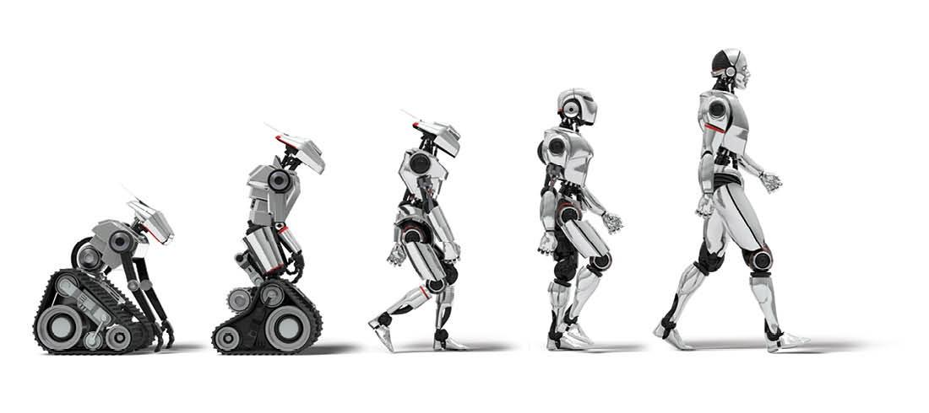
History of Robotics?
The word robotics was first derived from the word robot, which was introduced to the public by Czech writer Karel Cepek in his play R.U.R(Rossm’s Universal Robots) which was premiered in 1921.
The word robotics was first used in Runaround, a short story published in 1942, by Isaac Asimov.
But this was not until 1956 when the real robot came into existence.

Slide 6
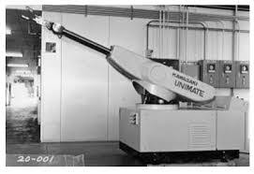
The First Robot “UNIMATE”
In 1956, the first programmable robot was designed by George Devol, who coins the term Universal Automation. It was the first digitally operated and programmable robot. It was installed in 1961 to lift hot pieces of metal casting machine and stack.
The Unimate started a revolution in robotics industry and many robots of its type were built for doing tiresome jobs for the people.
The original Unimate is consisted of a large computer like box, joined to another box and was connected to an arm, with systematic task stored in a drum memory.
In 2003 the Unimate was inducted into “The Robot Hall Of Fame”

Slide 7
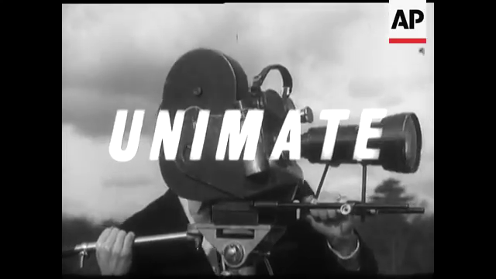
Unimate

Slide 8
The robotics technology
Most industrials robots have at least the following parts:
Manipulator or Rover: Main body of robots. (links, joints, other structural elements of robots)
End effecter: The part that is connected to the last joint of manipulator.
Actualators: Muscles of manipulators (servomotor, stepper motor, pneumatic and hydraulic cylinder.
Sensors: To collect information about the internal state of the robot or to communicate with the outside environment.

Slide 9
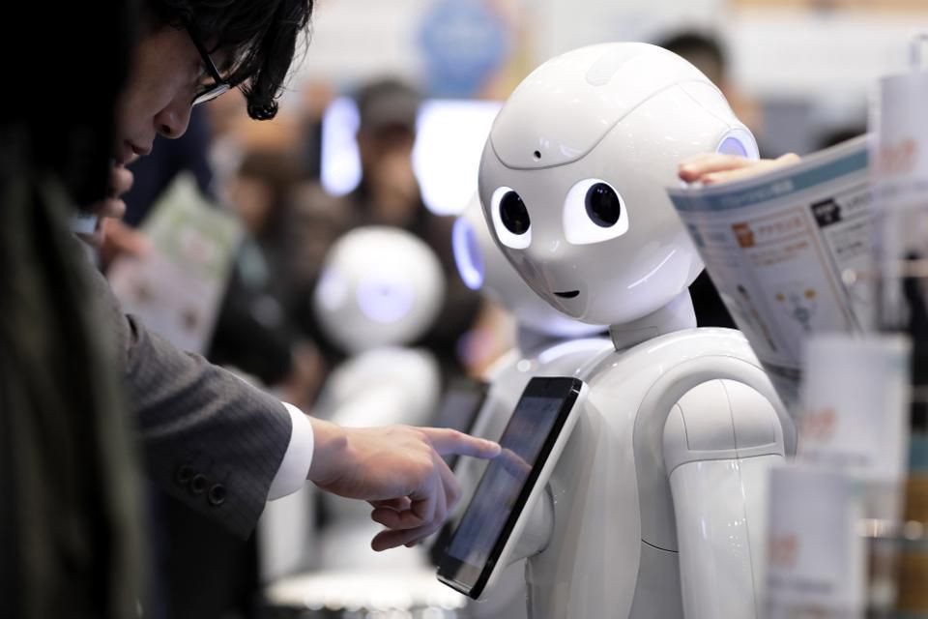
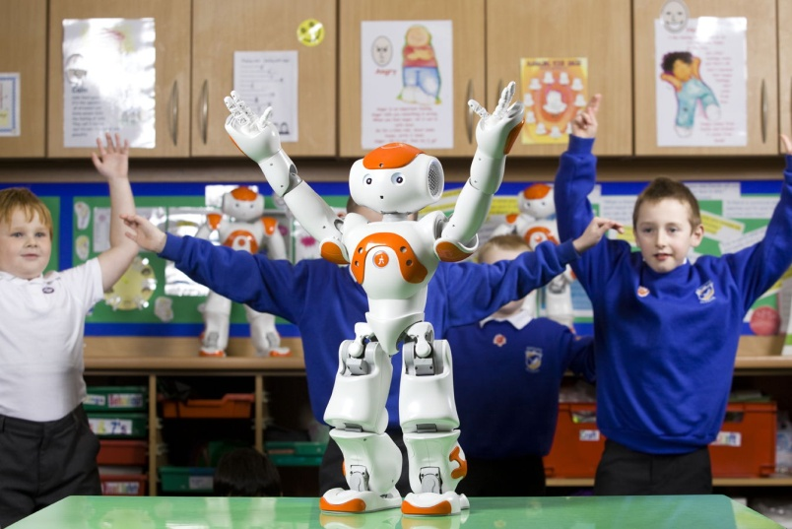
the future of robotics
What does the future hold for Robotics? It’s difficult to state, given the quick pace of progress in the field itself and the related ranges like machine learning and artificial intelligence. One thing however appears to be quite sure: Robots are assuming an undeniably critical part in business, schools and life in general.
Robotic engineers are designing the next generation of robots to look, feel and act more human, to make it easier for us to warm up to a cold machine.

Slide 10

Thankyou!

